Slide 1
SDT Ultrasound Solutions
VIGILANT
CONMONSense

Slide 2
AGENDA
Vigilant Specifications/options
Permanent
Mobility
Sensors/cables
Applications

Slide 3
Vigilant
Specifications/options

Slide 4
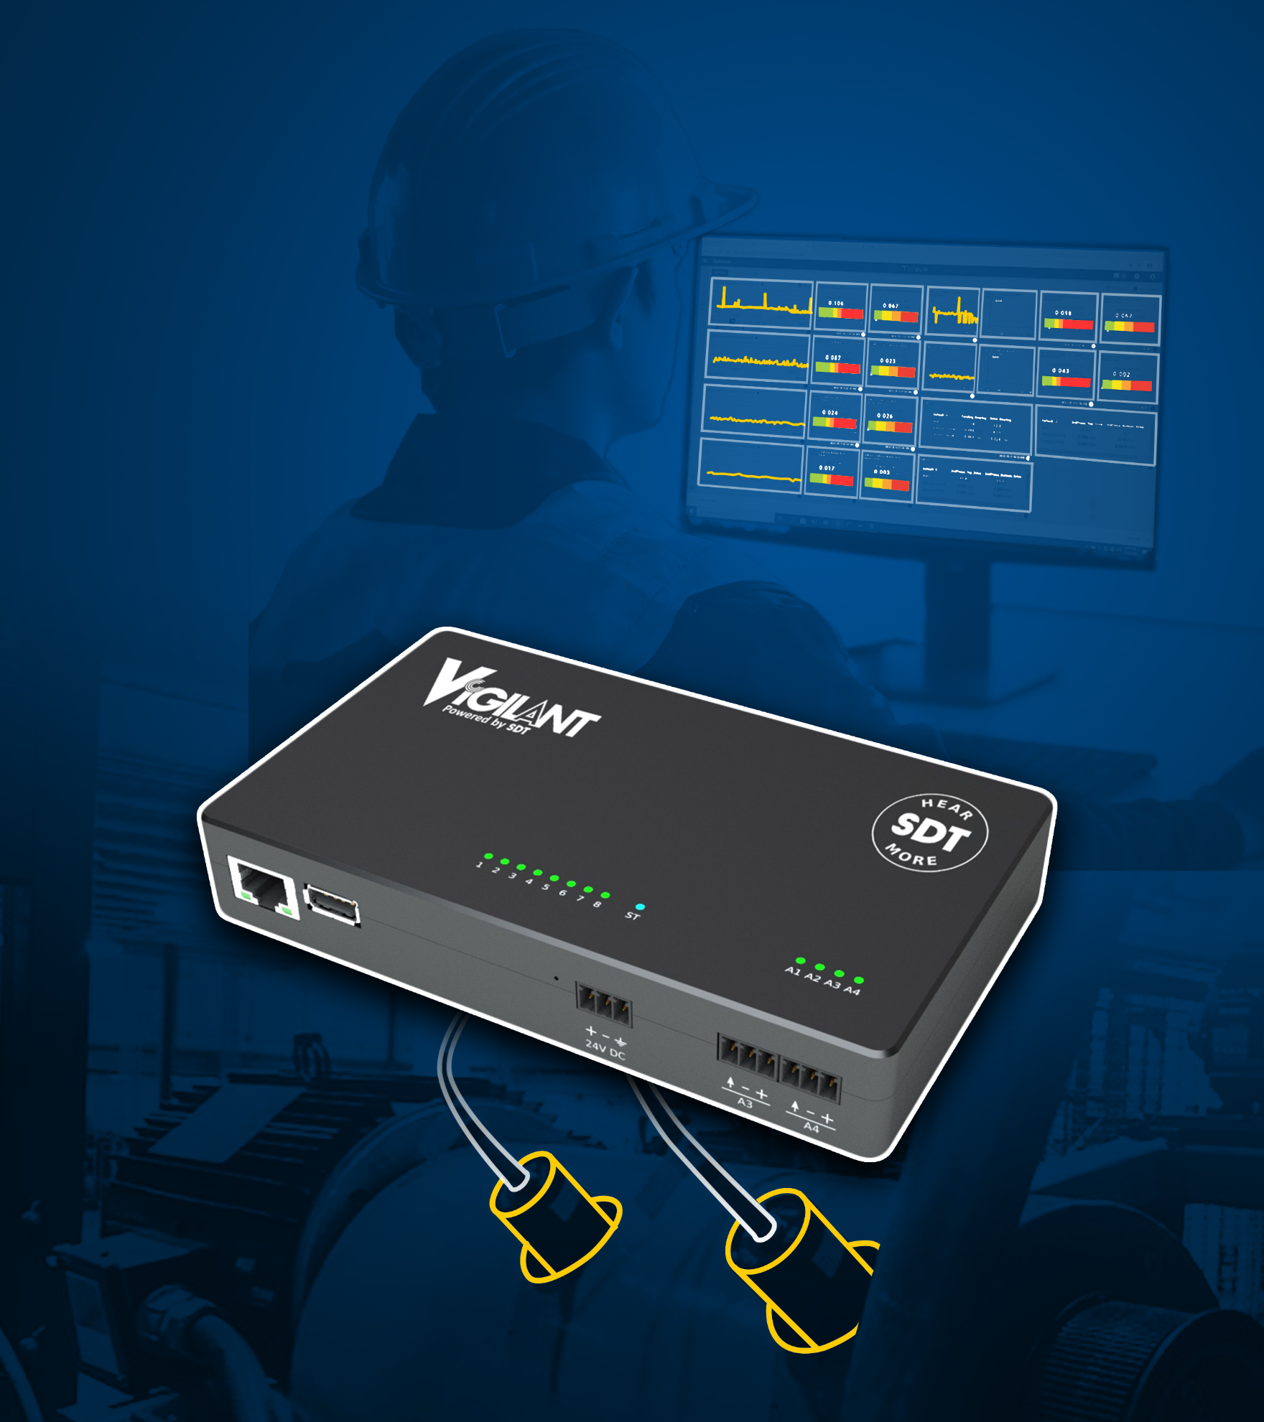
SELF-CONTAINED
CUSTOMIZABLE
AFFORDABLE
Solution that combines the versatility of ultrasound with the analytics of vibration analysis

Slide 5
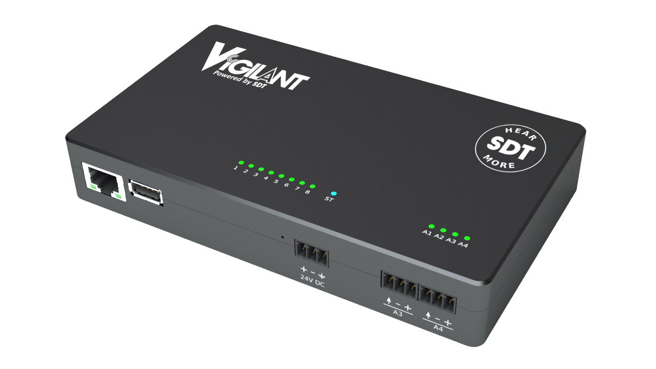
Description
Reliability departments now have 24/7 access to condition monitoring data from critical assets, both local and remote.

Slide 6
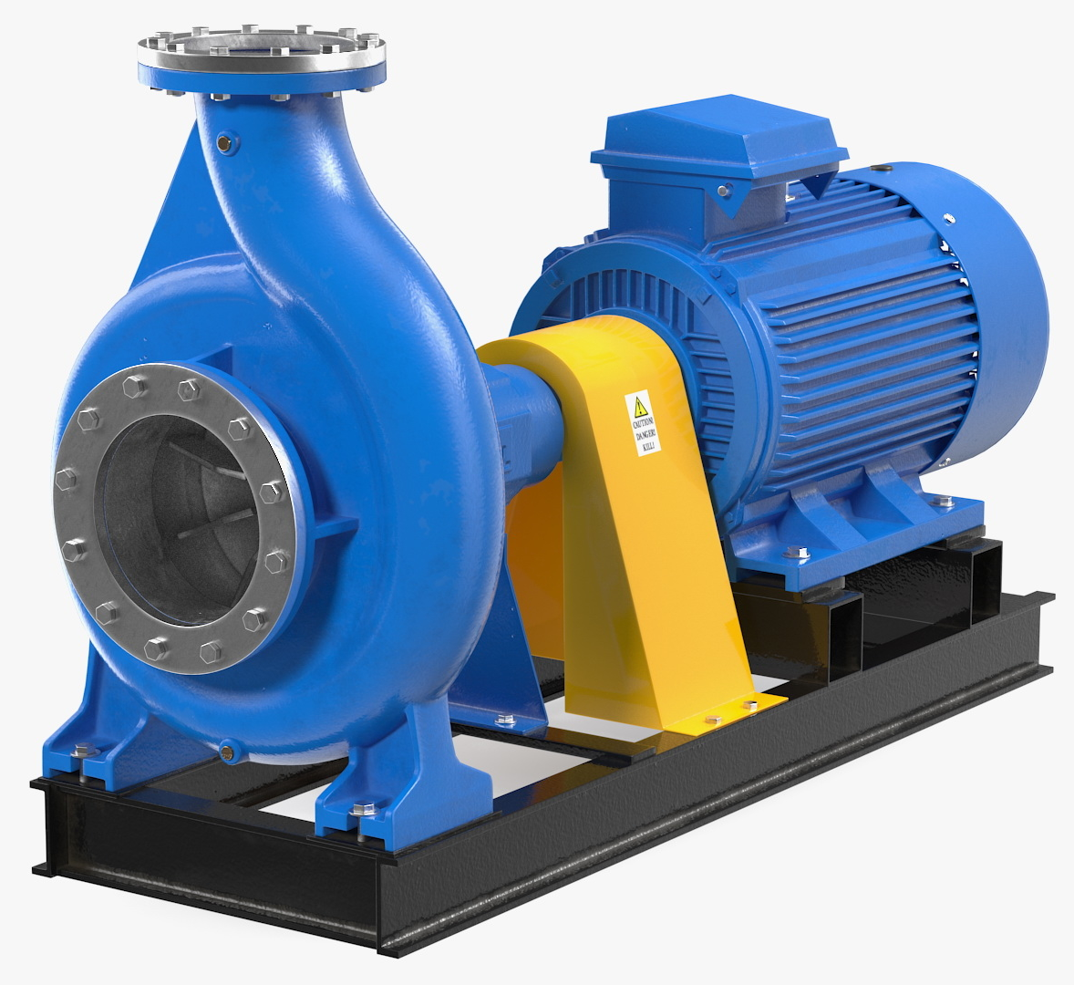
SELF-CONTAINED
Watch over assets deemed critical to operations by the Reliability department, and alert personnel when a change in status manifests.

Slide 7
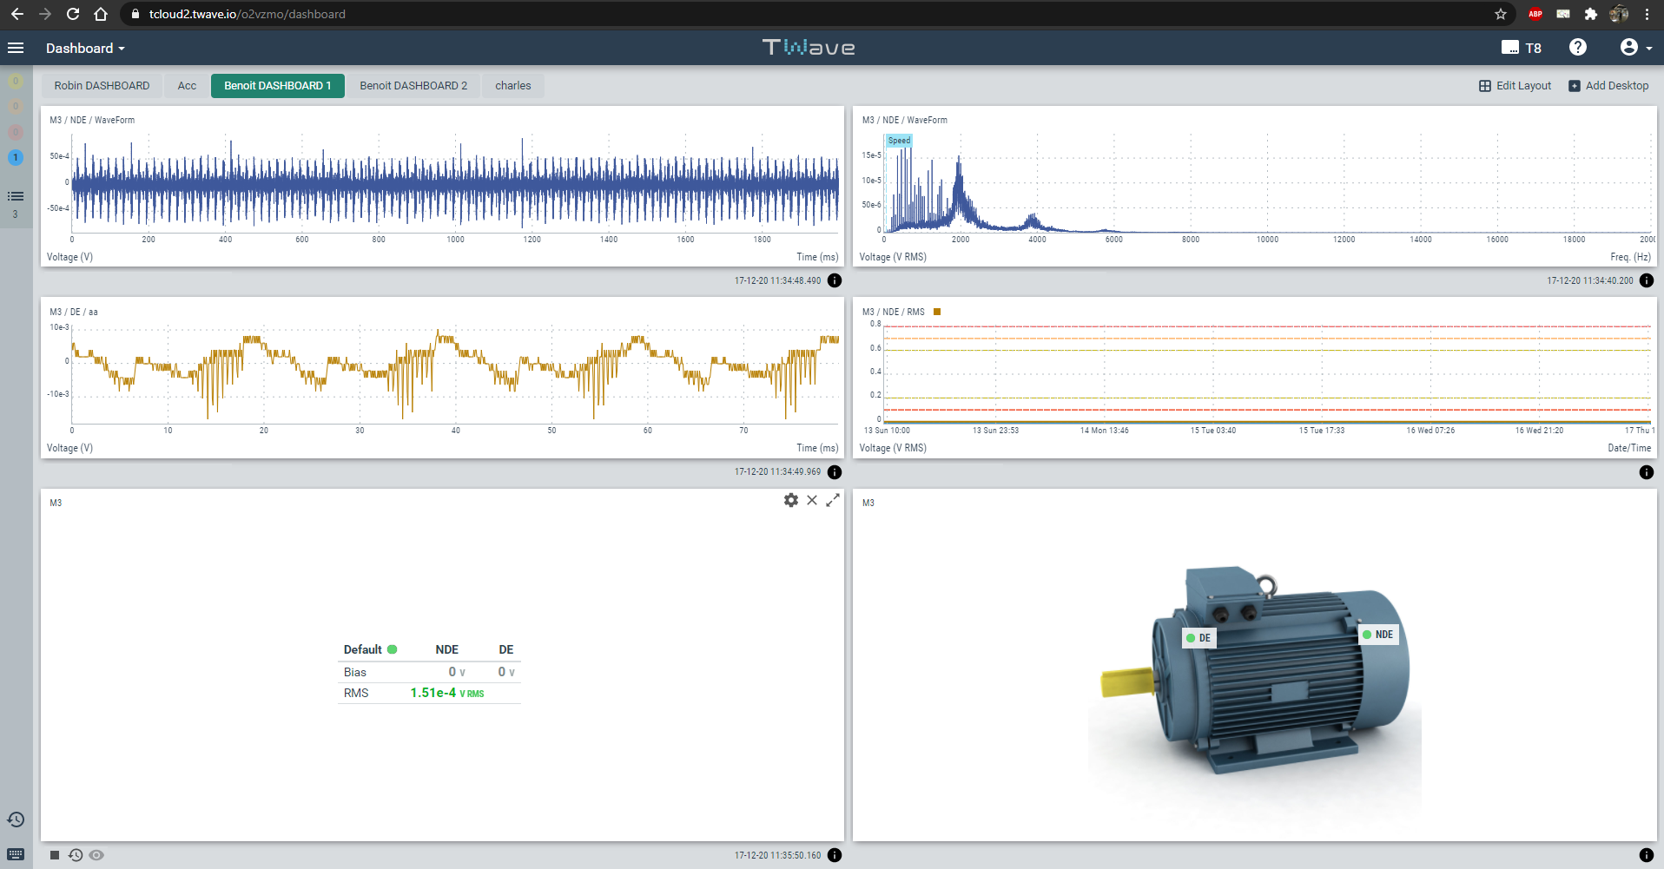
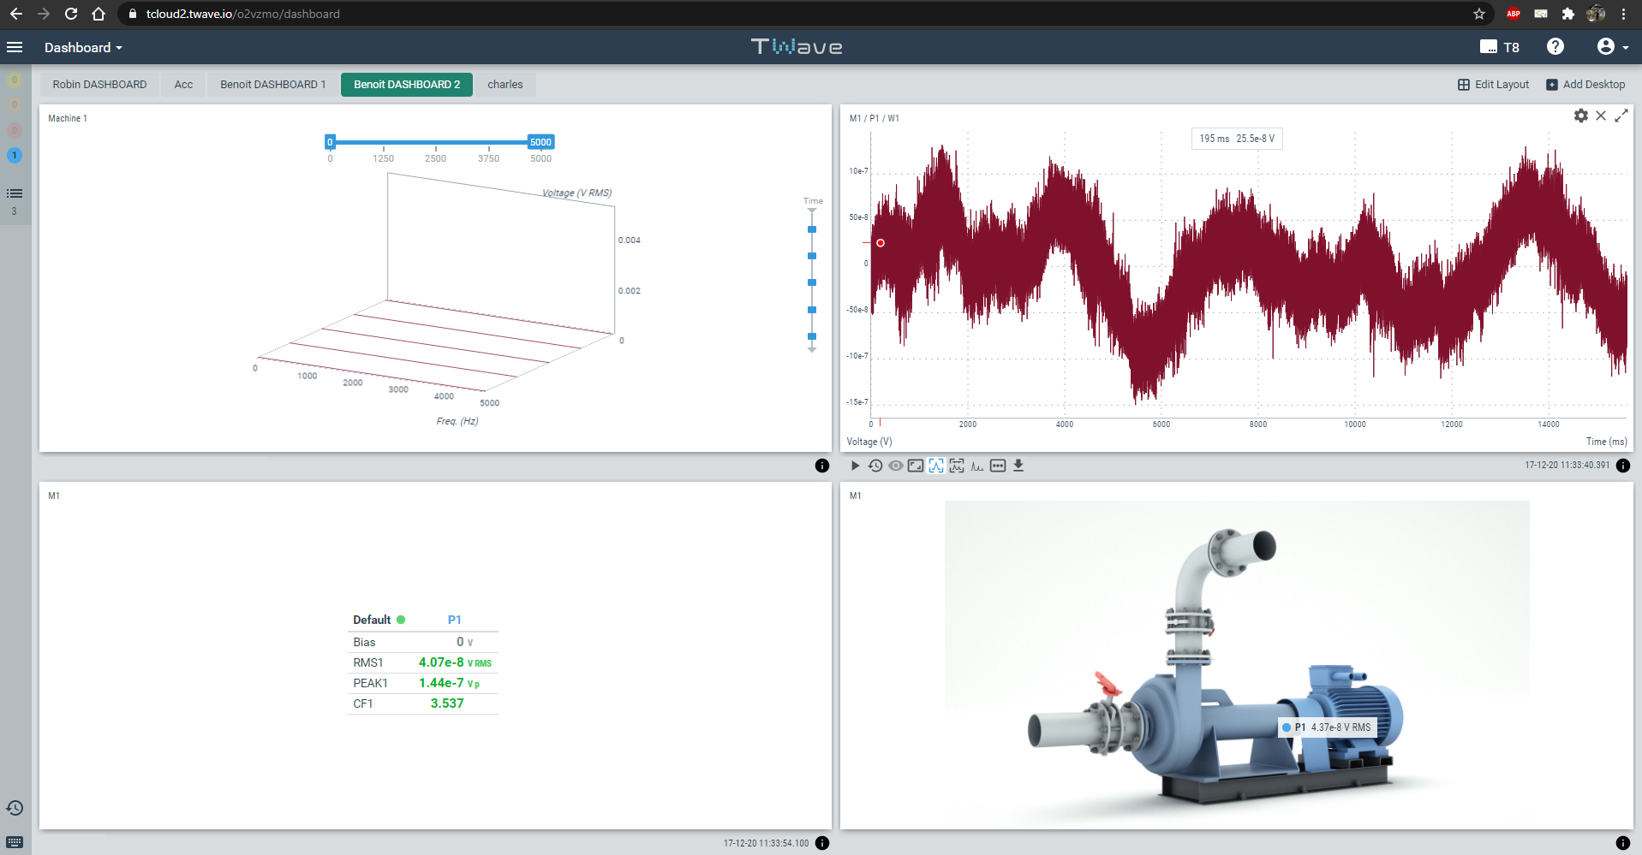
SELF-CONTAINED
The Vigilant integrates a web server that provides an interface for users through a web browser without having to install any software.

Slide 8
SELF-CONTAINED
Embedded data management software
Accessible by
Ethernet
Wifi
Cellular
Internal storage : 4 Gb

Slide 9
SELF-CONTAINED
Trending
Spectrum/waveform
Demodulation
Spectrum waterfall widget
Long waveform analysis

Slide 10
SELF-CONTAINED
Trending
Spectrum/waveform
Demodulation
Spectrum waterfall widget
Long waveform analysis

Slide 11
Size
The Vigilant is a small size & low consumption hardware device.
27 mm
119 mm
95 mm
420g
Power consumption < 12 W

Slide 12
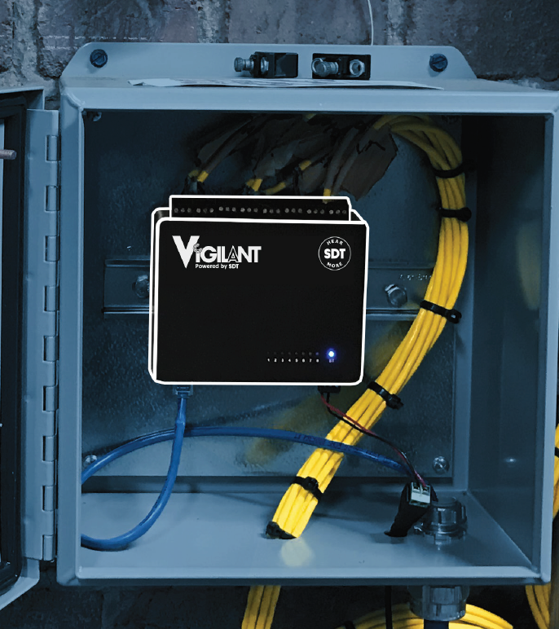
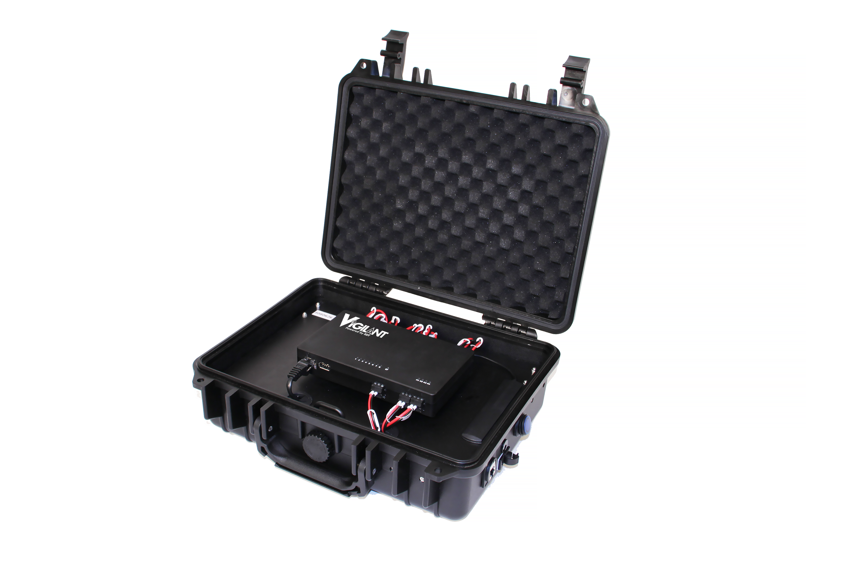

Slide 13
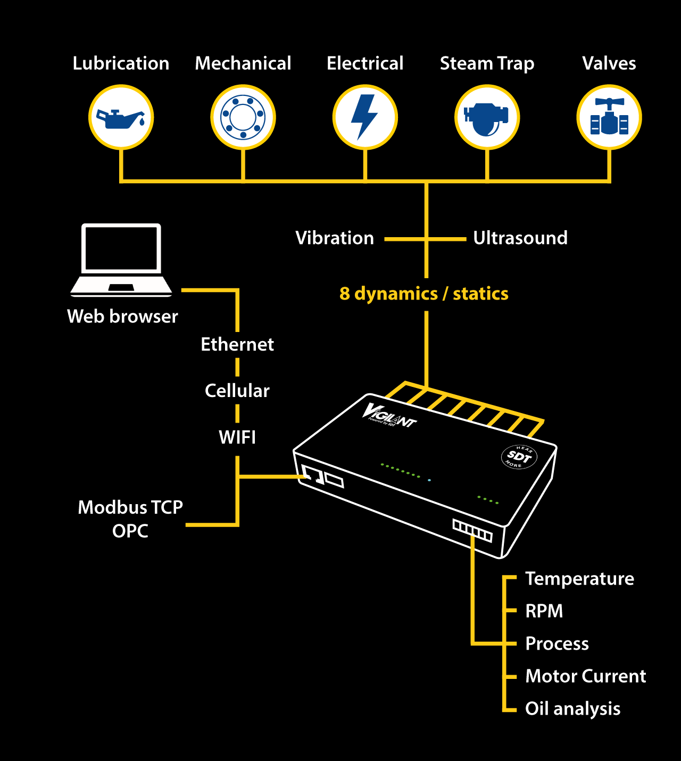
How it works

Slide 14
How it works

Slide 15
Data inputs
Motor Current
Ut
Vib
T°
RPM
Process
Oil analysis
speed,
motor current,
oil condition parameters,
load,
process,
The Vigilant accepts both static & dynamic signals from most kinds of sensors typically used for condition-based monitoring:
Ultrasound,
vibration,
temperature,
thermal images,
video,
etc.
Static & dynamic

Slide 16
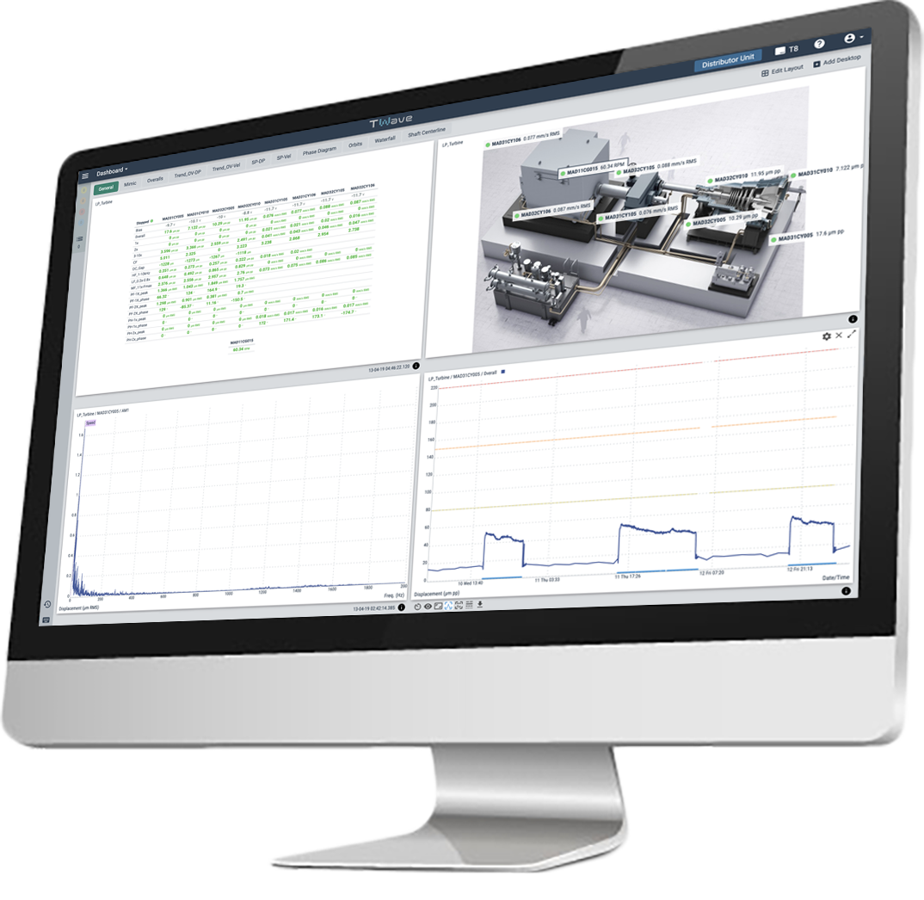
Communication
Modbus tcp
OPC
Wifi
Ethernet
Cellular
STANDALONE
onboard software
The Vigilant does not required a permanent connection to a computer or software, while still measuring and protecting the equipment, storing data or even communicating scalar measurements to other systems via Modbus-TCP protocol.

Slide 17
One hardware, two declinations
1. Permanent
2. Mobility case

Slide 18
1. Permanent
Features
Options

Slide 19
1. Permanent
Features
8 dynamic inputs
4 static inputs
Spectrum/waveform
Demodulation
Offline firmware upgrade
Modbus Master
OPC UA Client
Spectrum waterfall widget
Long waveform analysis

Slide 20
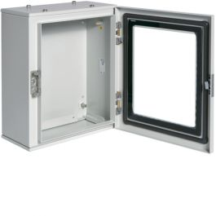
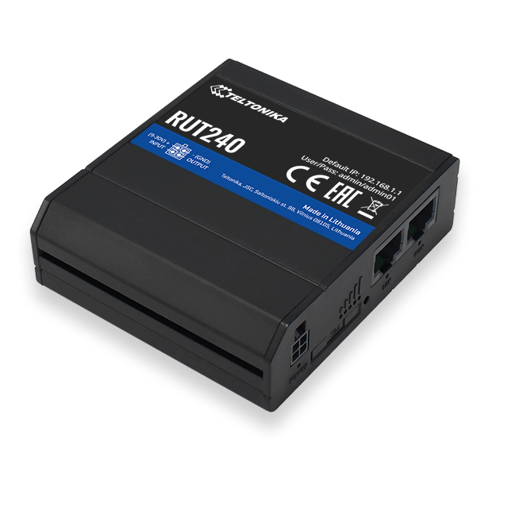
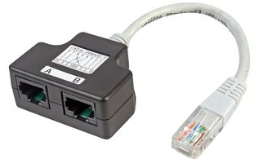
Options
1. Permanent
Switch and double ethernet connector
Modem Wifi/4G
IP65 Box - Size A ( 400x500x150 )
IP65 Box - Size B (500x700x250)

Slide 21
2. Mobility case
Features

Slide 22
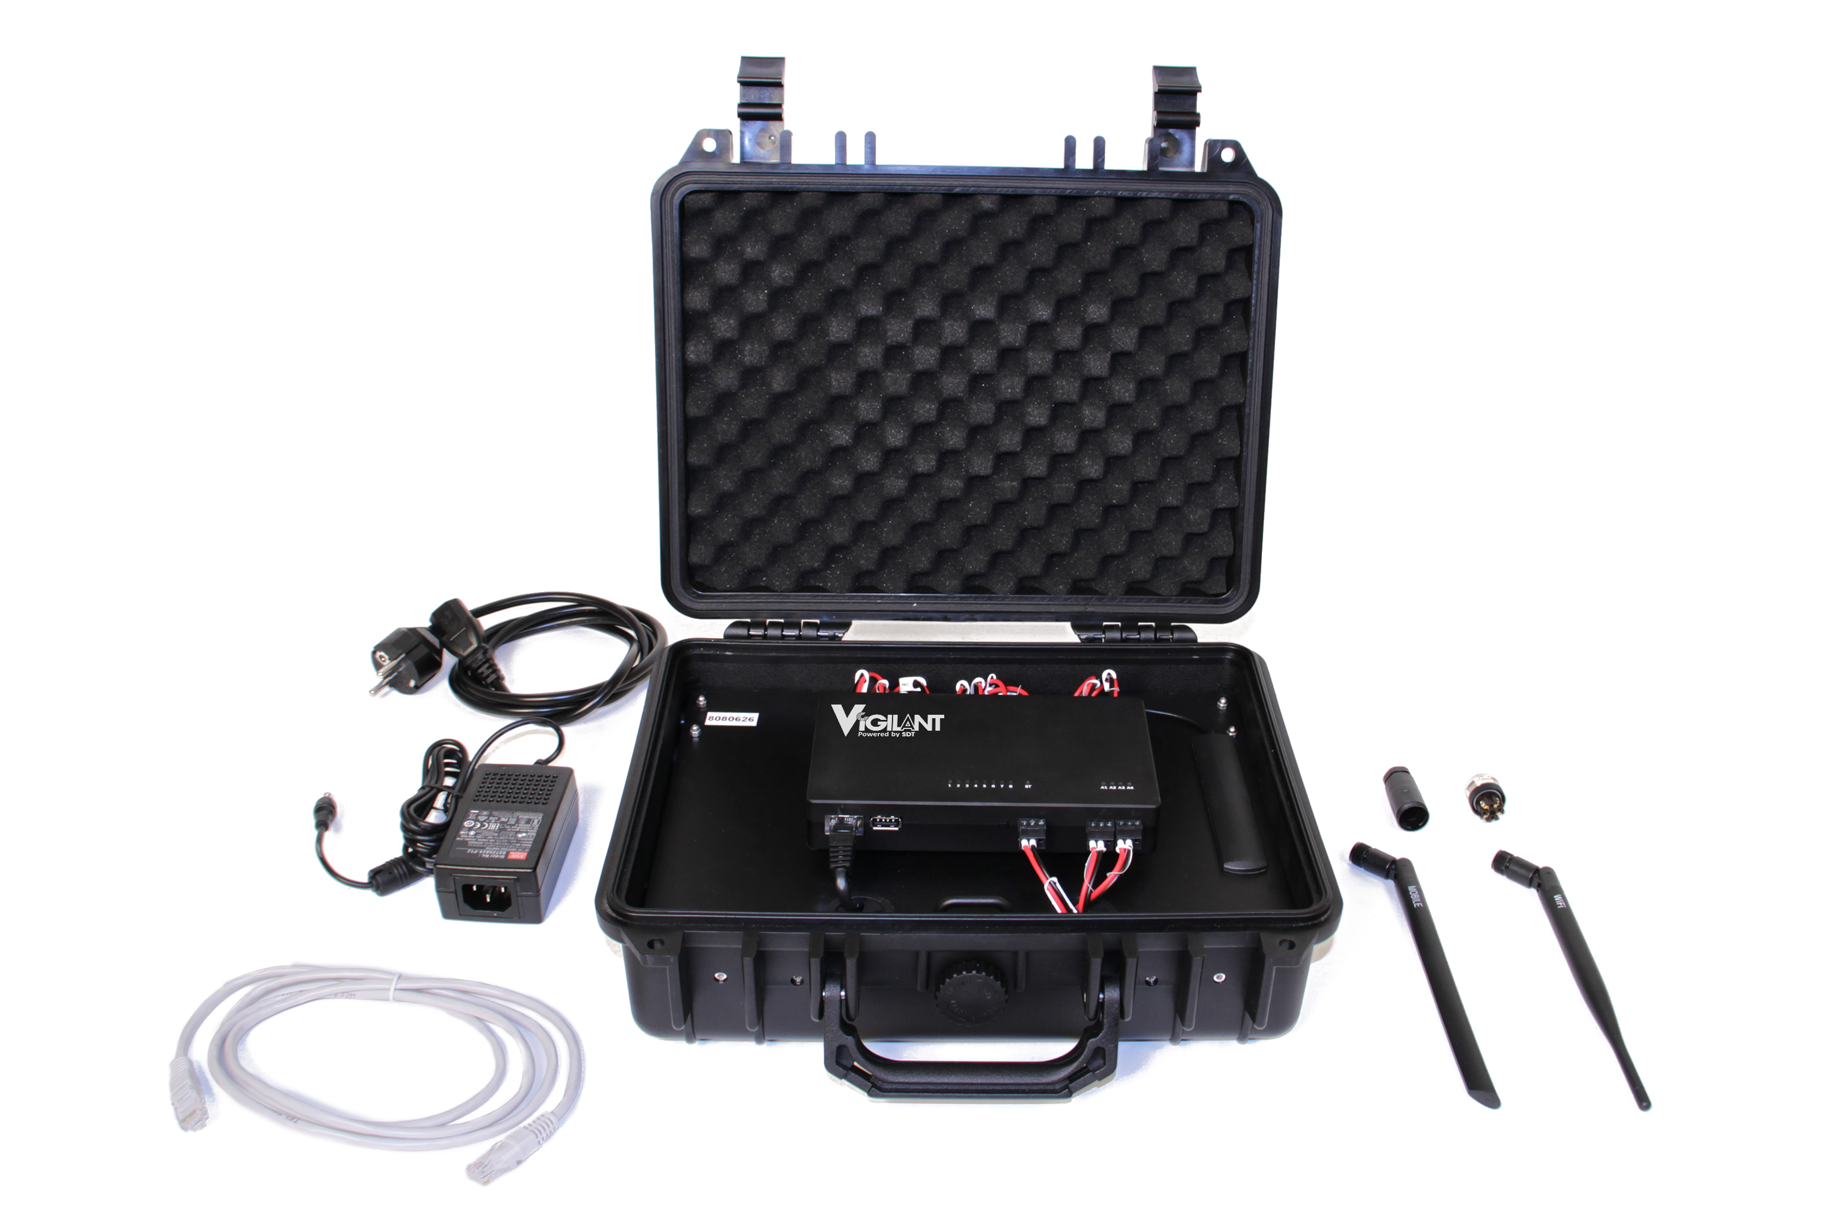
2. Mobility case
Features
8 dynamic inputs
4 static inputs
Spectrum/waveform
Demodulation
Offline firmware upgrade
Modbus Master
OPC UA Client
Spectrum waterfall widget
Long waveform analysis
Modem wifi/4G

Slide 23
Sensors & cables
CONMONSense

Slide 24
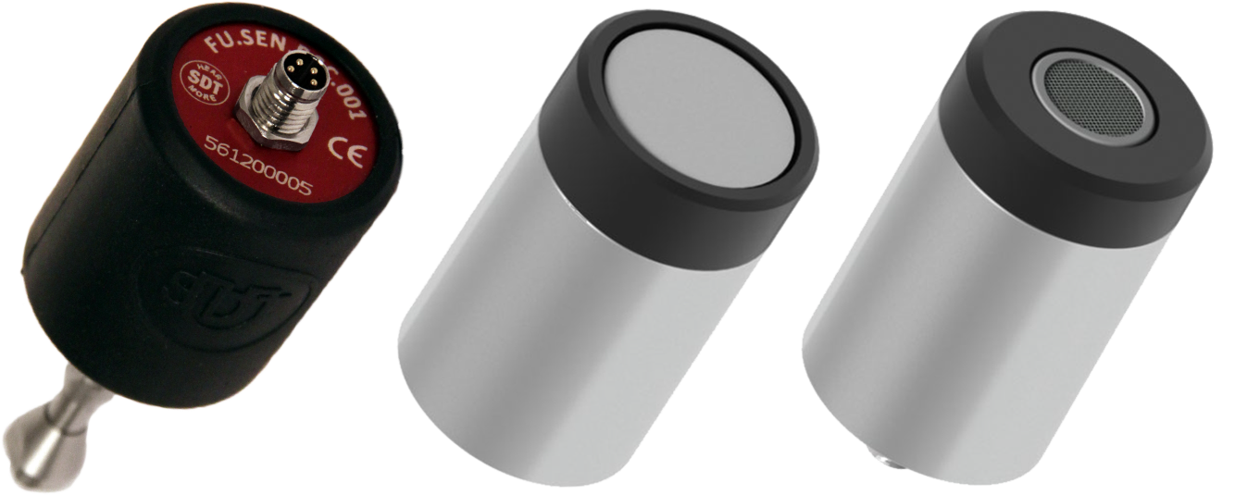
CONMONSense
Specifications

Slide 25
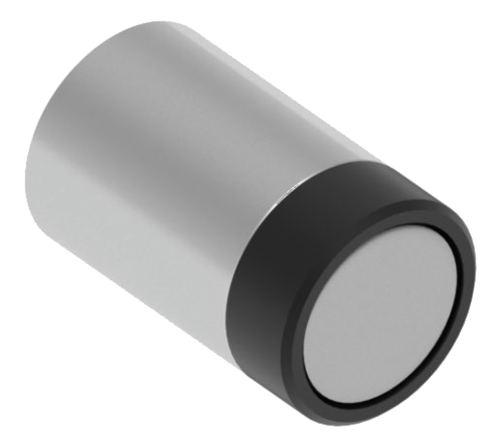
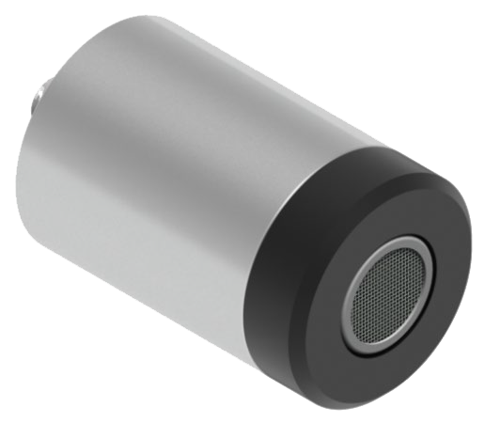
Specifications
Airborne sensor IP65/IP40

Slide 26
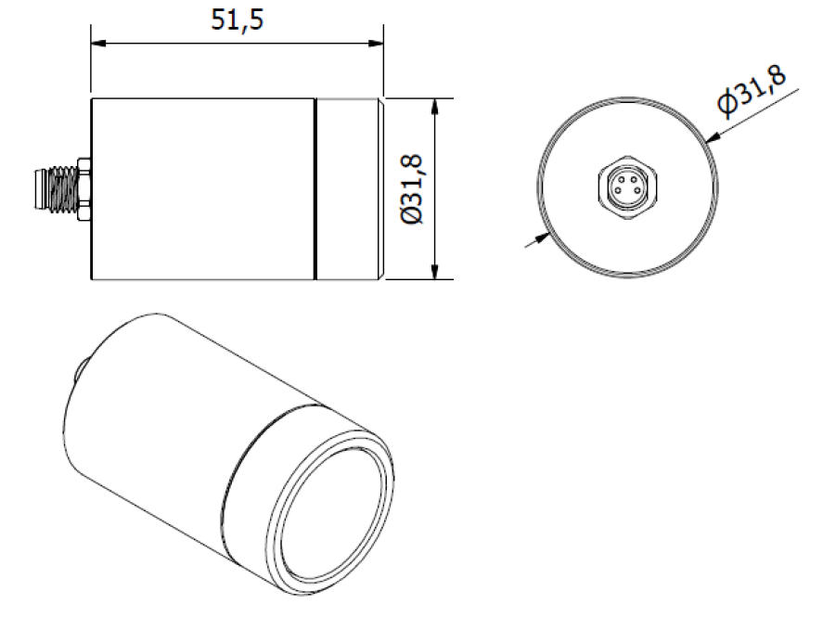
CONMONSense
Specifications

Slide 27
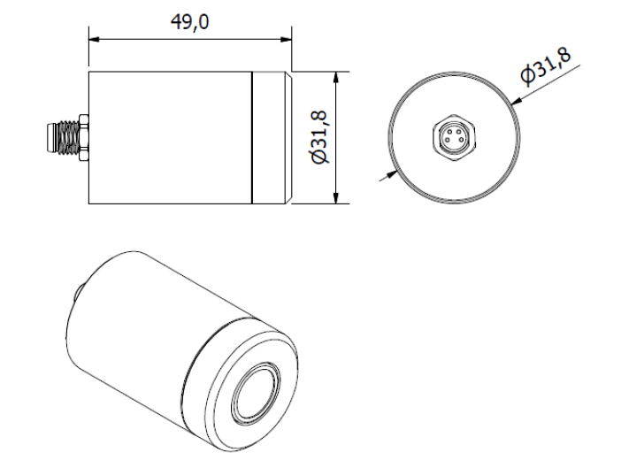
CONMONSense
Specifications

Slide 28
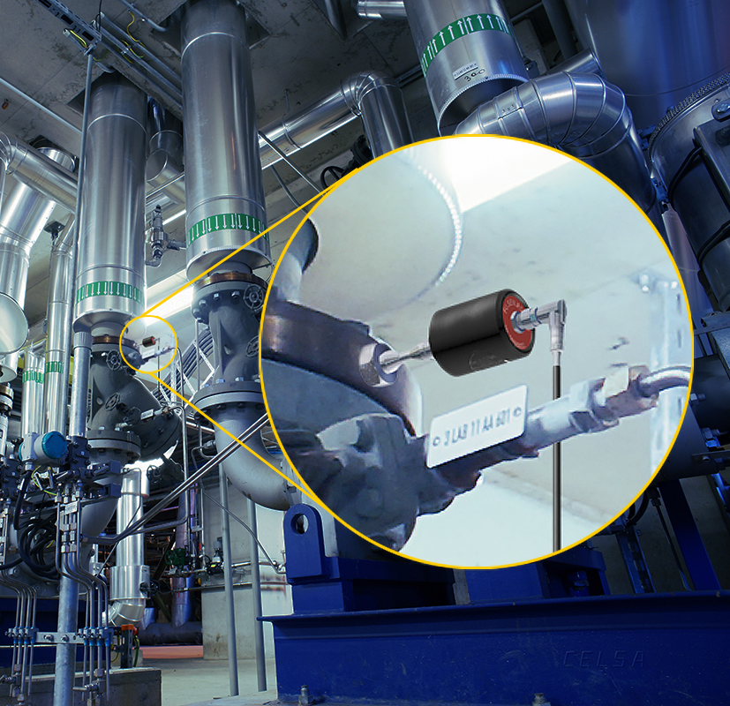
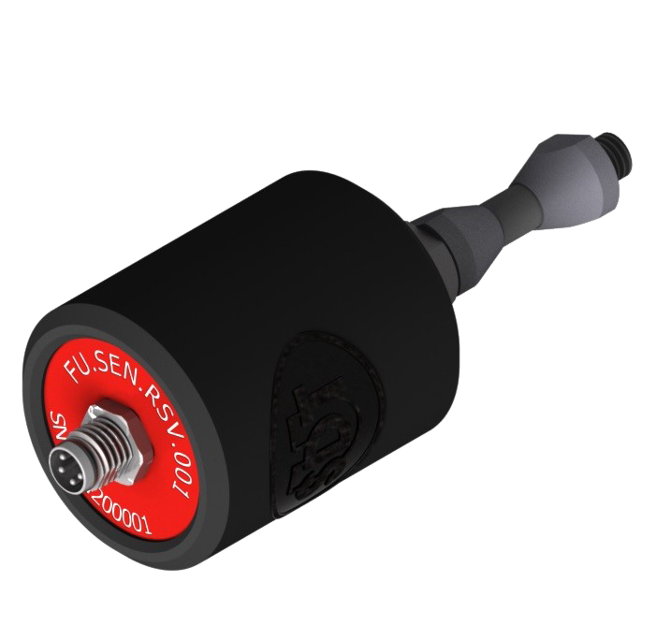
Specifications
Contact sensor IP65

Slide 29
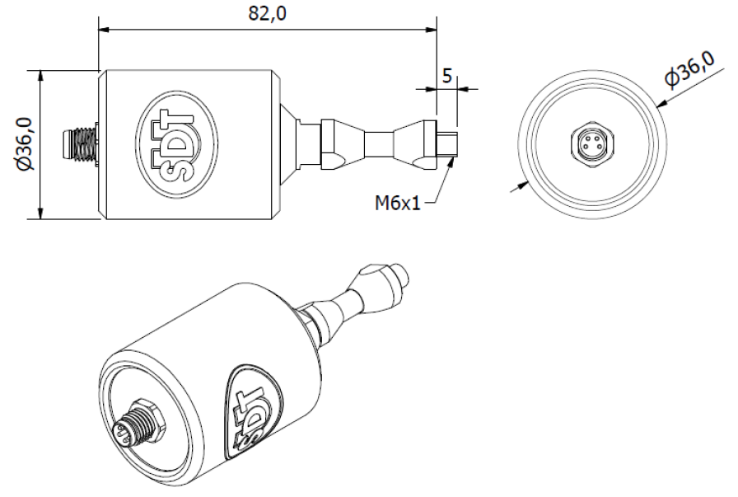
CONMONSense
Specifications

Slide 30
Cables
Specifications

