Slide 1
SDT TRAINING PORTFOLIO
Get Involved

Slide 2
AGENDA
Our offer
Get involved

Slide 3
AGENDA
Our offer
Get involved

Slide 4
OUR OFFER
SDT Ultrasound Solutions
With emphasis on SOLUTIONS
Means:
Hardware
Software
Training
Support
You miss one element – you miss success
Tell me why!

Slide 5
OUR OFFER
If the program fails ...
User will never blames himself
User will blame the equipment
User will blame US (SDT)
That’s understandable
Would you blame yourself, or your incompetence?
It seems that training is quite important

Slide 6
OUR OFFER
Training is, actually, critical
User’s success is our success
Not talking about the typical sales phraseology
No emotions there
No knighthood
Successful user is worry-free sale
Successful user is a FREE MARKETING

Slide 7
OUR OFFER
Besides that, training is a product
You sell products, right?

Slide 8
OUR OFFER
Include training as your important product
It increases your turnover
It bolsters your success
It puts you in a closer relationship with the user
You learn more

Slide 9
OUR OFFER
What is on the menu?
Lvl1 & Lvl2
CAT I
SDT Ultrasound Power User
SDT-IMCS Ultrasound Marine Power User
LUBExpert Implementation Master Class

Slide 10
OUR OFFER
I am sure you are familiar with
Lvl1, Lvl2, and CAT I
Any questions on that?
What is missing there, for your average client?

Slide 11
OUR OFFER
More practical?
More knowledge about Reliability improvement tools?
FMEA, RCA, CA, RCM ...
More about culture change?
More about the implementation process?
At least basics ... that would help a lot, right?

Slide 12
OUR OFFER
LUBExpert Implementation Master Class
Is a good example of expanding the training topics
Covering WHY, WHAT, and HOW
It is being sold as an integral part of the LUBExpert
How big of a value do you see in that?
Expanding works, we offer what user needs

Slide 13
OUR OFFER
Just to avoid misunderstanding!
Expanding is exactly that - EXPANDING
It does not make Lvl1, Lvl2, or CAT I unnecessary
On the contrary!
It expands AROUND those trainings
They are complementary

Slide 14
OUR OFFER
Newest one is :
SDT Ultrasound Power User
Built around Lvl1
Reliability basics added
More practical added
Implementation skills and culture change added

Slide 15
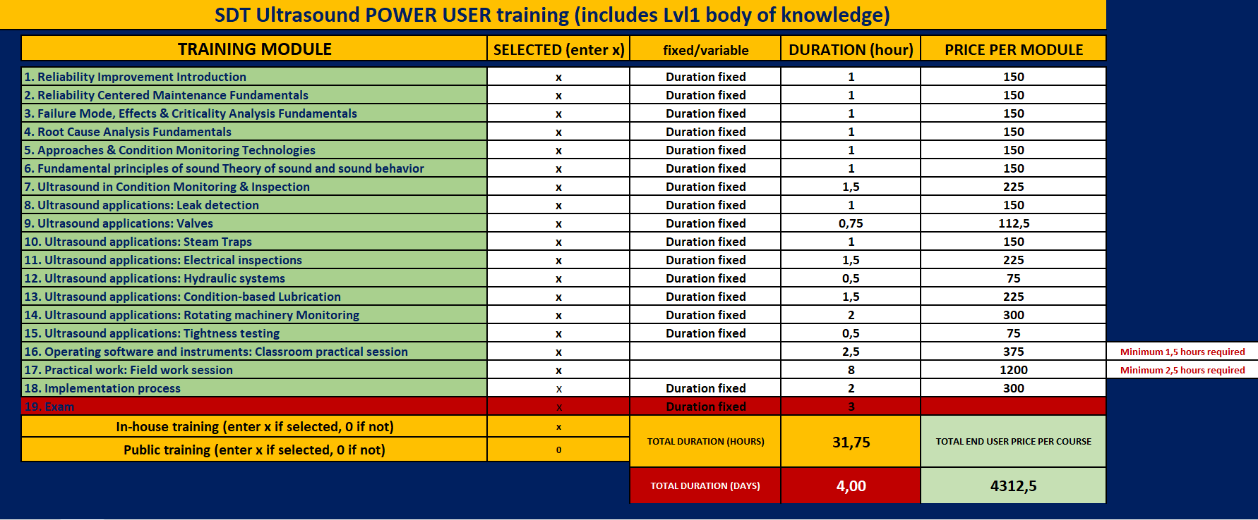
OUR OFFER
Concept (just to scratch the surface)

Slide 16
OUR OFFER
Choose exactly what your user needs
You will know the duration and price
You will know what will be done
You know what is needed
You can start with several modules, continue later

Slide 17
OUR OFFER
Good, hard-working candidates will be awarded with:
Lvl1 certificate
SDT Ultrasound Power user certificate
In the expanded version (more hours) CAT I certificate
Does this make your life easier?

Slide 18
OUR OFFER
Good, hard-working candidates will be awarded with;
Lvl1 certificate
SDT Ultrasound Power user certificate
In the expanded version (more hours) CAT I certificate
Does this make your life easier?

Slide 19
OUR OFFER
SDT-IMCS Ultrasound Marine Power User
Is a version adjusted to the marine sector

Slide 20
OUR OFFER
LUBExpert Implementation Master Class
Just as an example ...
And the number is growing

Slide 21
AGENDA
Our offer
Get involved

Slide 22
GET INVOLVED
Promote training
Does this help you?
Sell training as a highly important product
Does this help you?
Become a trainer
Does this help you?

Slide 23
GET INVOLVED
Become a trainer
If you qualify, we now offer this as an opportunity
Strengthen your position on the market
You promote the solution
You present and demonstrate
You sell
You train
Your market will trust you

Slide 24
GET INVOLVED
Training in local language
How important is this?
Training by a local person
How important is this?
Not only a salesman, a trainer
Doesn’t it put you in a completely different position?

Slide 25
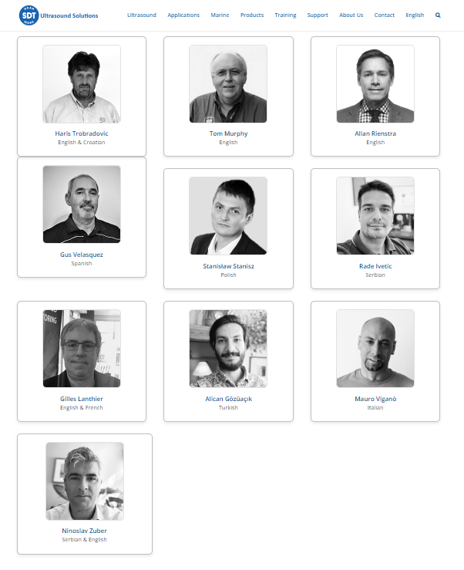
GET INVOLVED
We are proud of our current LIMC trainers

Slide 26
GET INVOLVED
We would like to see your name there ...
We would like to expand it to Power User training as well
Get involved!

Slide 27
WHAT DO YOU NEED TO GROW
We listen

Slide 28
AGENDA
Simple agenda, just one question

Slide 29
WHAT DO YOU NEED TO GROW?
You speak, we listen

Slide 30
ELECTRICAL MOTORS CM
by Mark Gurney

Slide 31
TITLE
Bullets

Slide 32
LET’S WRAP IT UP
With some Q&A included

Slide 33
OVERVIEW
CRYSOUND
Most of you already have your camera
We believe you already know a lot
I hope you feel more confident now
We have all it takes to dominate the market!

Slide 34
OVERVIEW
VIGILANT & CONMONSense
Important segment of SDT’s portfolio
Represents a big portion of the market
We hope you feel more confident now

Slide 35
OVERVIEW
TRAINING
Training area is growing, and becoming critical
Get involved!

Slide 36
OVERVIEW
GROWTH
Thank you for your feedback!
We’ll do everything possible to give you all the tools
For success

Slide 37
OVERVIEW
EM CM training opportunity
As a part of the “Knowledge sells Solutions” approach;
We will organize a two-day training with Mark, at SDT
Just let us know about your attendance

Slide 38
OVERVIEW
LUBExpert ON-GUARD
Final part of the complete strategy puzzle
ODR (LUBEChecker)
Handheld (LUBExpert)
Online (LUBExpert ON-GUARD)
You attended a pre-launch training, to make you ready
To make you COMPETENT

Slide 39
OVERVIEW
LUBExpert ON-GUARD DEMO KIT
Is essential for the moment of launch
To make you CAPABLE
It is critical to have a demo kit to be part of the launch

Slide 40
OVERVIEW
Join in!

Slide 41
Q&A
If there are still some questions ...
We didn’t do a good job ☺
But go ahead

Slide 42
Thank you!
Time for hugs an kisses

